Slide 1
Entrepreneur Wines
Consumer Website Wireframes

Slide 2
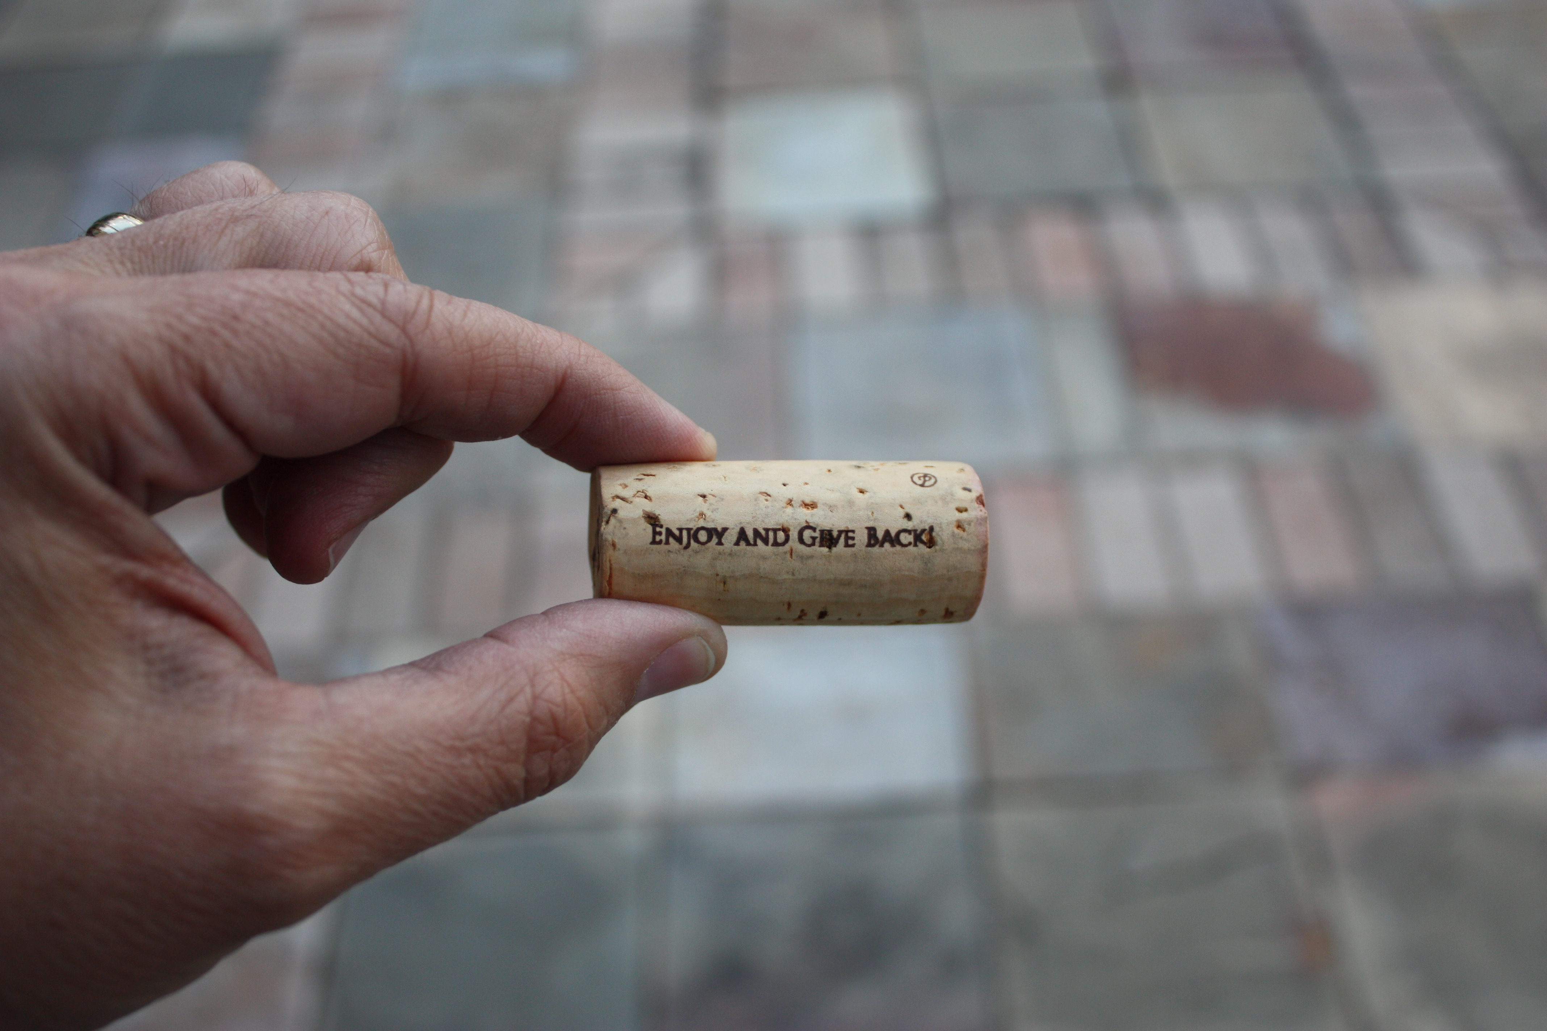

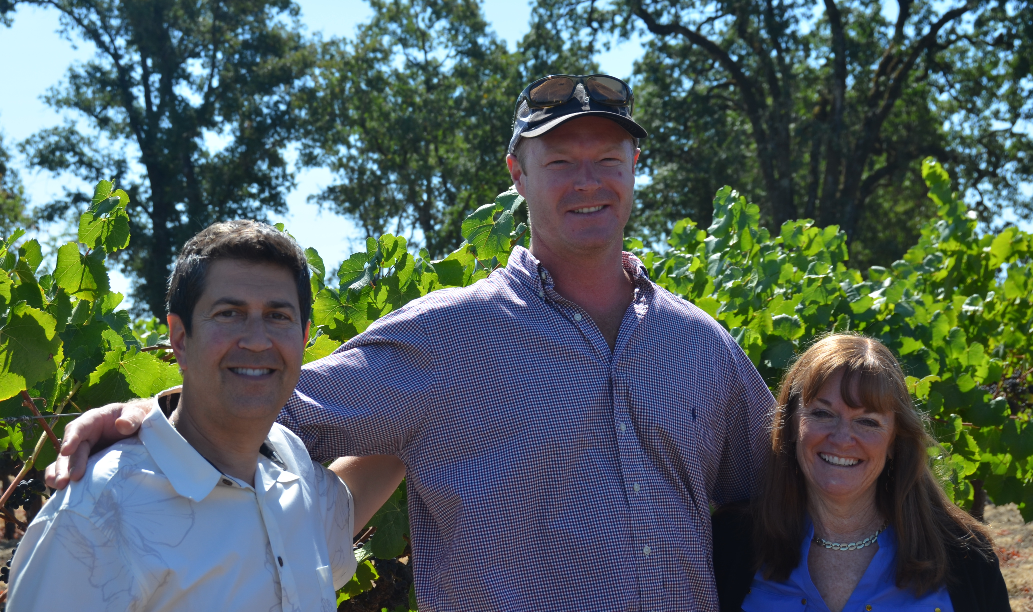
HOME Page – Entrepreneur
MENU: (12 subpages)
About
Wines
- Chardonnay
- Pinot
- Cabernet
Club Page
Wine Club info &
Sign-up for clubs
Praise & Events
- Wine Credits
- Blog/Events
- Restaurant listing
My Cart
Pop-up for Newsletter sign-up offer
Home About Wines Praise & Events Cart Contact Us 925-461-9600
THE SPIRIT OF ENTREPRENEURSHIP INTERSECTS WITH AMAZING WINES!
OUR WINES ARE UNIQUE:
Sourced from amazing Napa/Sonoma vineyards
Extremely Limited production
Awards & accolades - winemaker, Kirk Venge
Strongly support a social mission .

Slide 3
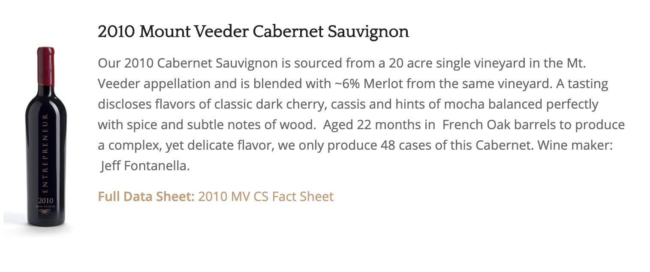
WINES Top Page
OUR WINES
Home About Wines Buy Praise & Events
Photo of
collections
Photo of
Single btl
Photo for Gifts/Samples
COLLECTIONS
SINGLE VINEYARDS
GIFTS & SAMPLERS

Slide 4
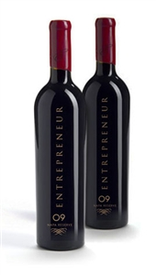
WINE COLLECTIONS Page
WINE Collections
There will be 3 bundles offered initially. Each would have:
Description of contents of bundle
Hotlink (to SingleVineyard page) to the each of the Single Vineyard wines listed in the bundle
Home About Wines Buy Praise & Events
Collection One: This will be a description of this bundle:
Single Vineyard 1 (hotlink)
Single Vineyard 2 (hotlink)
Etc.
Collection
One Photo
Purchase
Collection Two: This will be a description of this bundle:
Single Vineyard 1 (hotlink)
Single Vineyard 2 (hotlink)
Etc.
Collection
Two Photo
Purchase
Collection
Three Photo
Collection Three: This will be a description of this bundle:
Single Vineyard 1 (hotlink)
Single Vineyard 2 (hotlink)
Etc.
Purchase

Slide 5
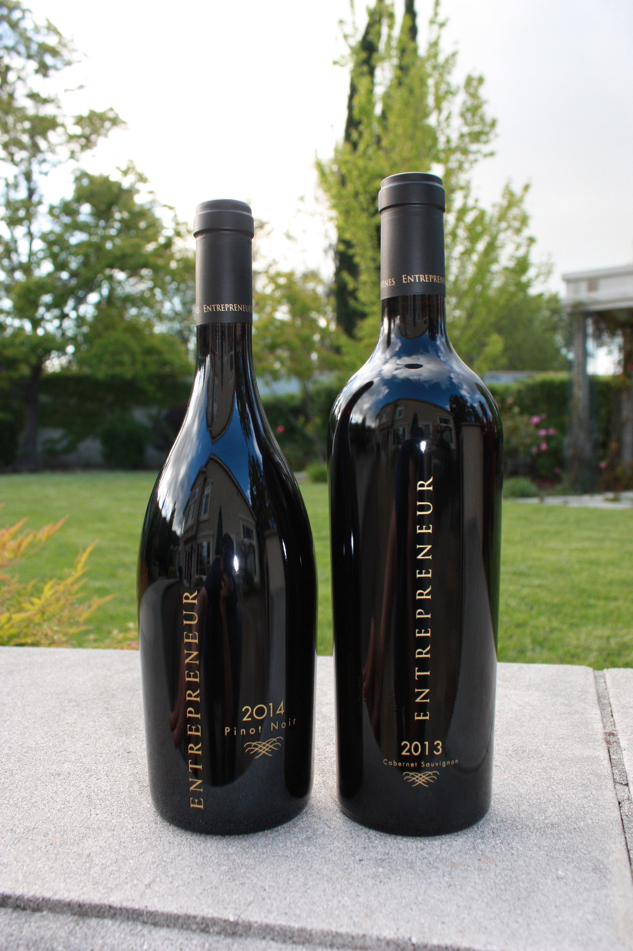
WINE GIFTS Page
WINE Gifts & Promos
There will be 3 bundles offered initially. Each would have:
Description of contents of bundle
Hotlink (to SingleVineyard page) to the each of the Single Vineyard wines listed in the bundle
Home About Wines Buy Praise & Events
Gift Set One: This will be a description of this bundle:
Single Vineyard 1 (hotlink)
Single Vineyard 2 (hotlink)
Etc.
Purchase
Gift Set Two: This will be a description of this bundle:
Single Vineyard 1 (hotlink)
Single Vineyard 2 (hotlink)
Etc.
Gift Two
Photo
Purchase

Slide 6
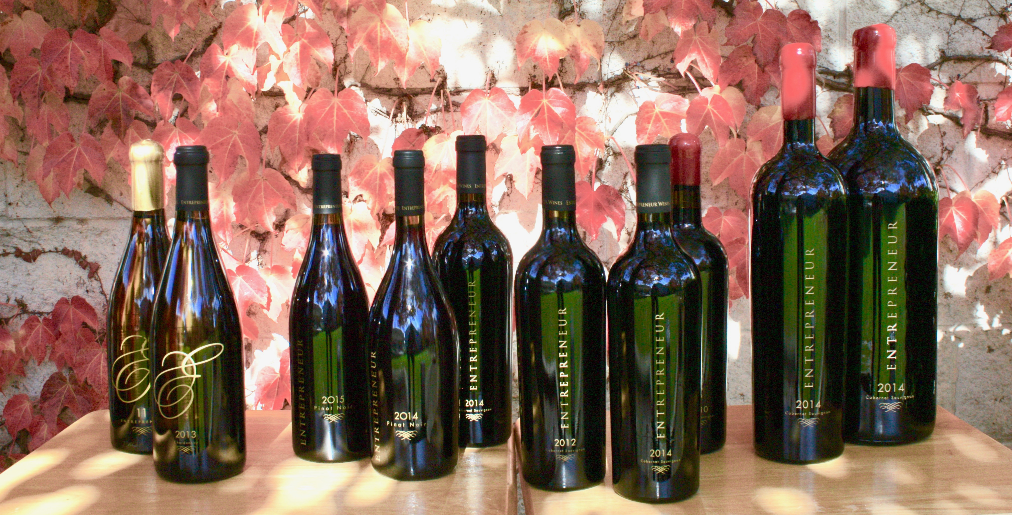
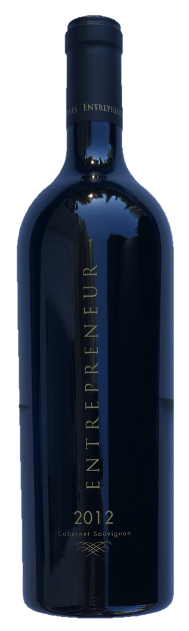
WINE By The Bottle - Page
WINES – Single Vineyard
There will be 3 bundles offered initially. Each would have:
Description of contents of bundle
Hotlink (to SingleVineyard page) to the each of the Single Vineyard wines listed in the bundle
Home About Wines Buy Praise & Events
Our Philosophy: This will be a description of this bundle ipsum liod gib egie re gdgj adf anger ag dger gege
*SPECIAL OFFER*
Photo of 3 bottles (cab, pinot, chard)
Go to… Our Chardonnays
Go to…Our Pinot Noirs
Go to…Our Cabernets
special
2009 Diamond Mountain Cabernet - This will be a description of this bundle ipsum liod gib egie re gdgj adf anger ag dger gege See Details (hotlink to indiv. page)
Purchase
2009 Diamond Mountain Cabernet - This will be a description of this bundle ipsum liod gib egie re gdgj adf anger ag dger gege See Details (hotlink to indiv. page)
Purchase

Slide 7
WINES Page – Entrepreneur
Home About Wines Buy Praise & Events
COMMENT:
Product description
PRODUCT A
WINE PROFILE
WINE PROFILE
WINE SPECIFICATIONS
COMMENT:
Winemaker’s comment
Doowload Tech Sheet
Purchase
WINEMAKER’S REVIEW

Slide 8
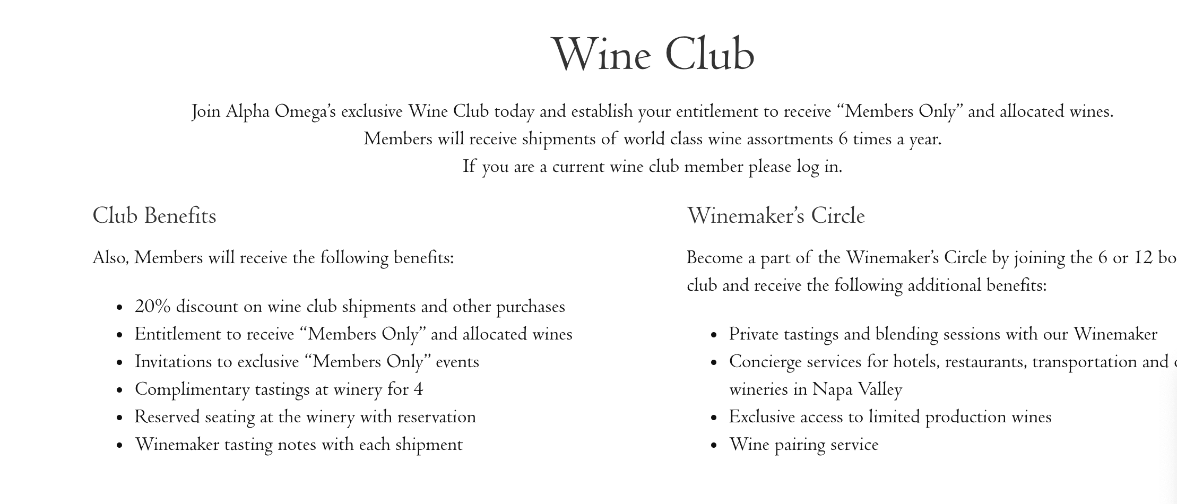
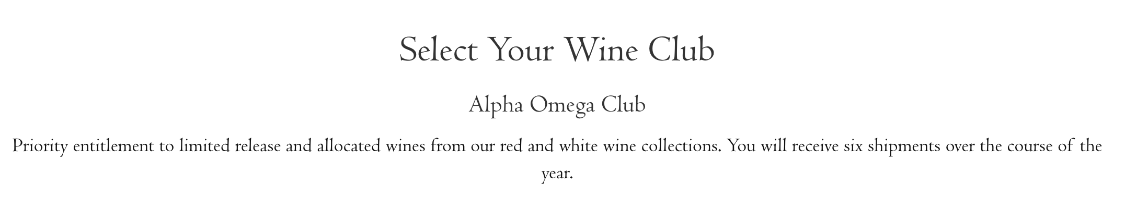
WINES Top Page
WINE CLUB
Home About Wines Buy Praise & Events
This section could look similar to the Alpha Omega CLUB page…
Ambassador
Photo
Champion
Photo
Patron
Photo
AMBASSADOR
CHAMPION
PATRON

Slide 9
Additional Issues
Each customer account needs to have a discount associated with it:
Ambassador – 10% (purchase 4 btls)
Champion - 15% (purchase 8 btls)
Patron – 20% (purchase 12 btls or more)
Tax needs to be added (Calif. State tax)
Some transactions are tax free (restaurants and wholesale)
Shipping – based on # of bottles – needs to be entered into system
Some customers get hand-delivery with no shipping
Order entry on my own – I’d like to be able to enter myself
Integration with Shopify:
Save new members saved into MailChimp
60 customer accounts
to transfer from Volusion – they all have
Migration Volusion credit card info for each customer into Shopify

